Slide 1

Hardware Design in VHDL for MNG (Measurement Network Gateway)
Master of Science in Embedded Systems Design
Mohammad Mahdi Mohammadi - 42719

Slide 2

Table of contents
Hardware Design using VHDL
Application for MNG
MNG client (GUI)

Slide 3
Hardware Design using VHDL
Sensors to be measured:
ADC0
ADC1
Temperature Sensor
Push Buttons
Switches
For measurement of the above sensors, different modules are written in VHDL language in Vivado Design Suite and the end all the modules are integrated into one single IP (Intellectual Property).

Slide 4
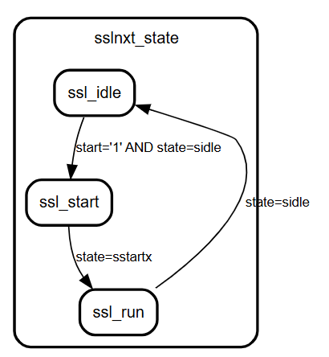
ADC0 and ADC1 Measurement
Their values are acquired through a dual-lane SPI-based ADC interface.
The architecture contains two FSMs: one control FSM for start/stop handling, and one SPI FSM for the bit-level ADC data acquisition.
ssl_idle: wait for a new start command and signal ready.
ssl_start: generate the internal start pulse for SPI transfer.
ssl_run: wait until the SPI FSM finishes and returns to idle.

Slide 5
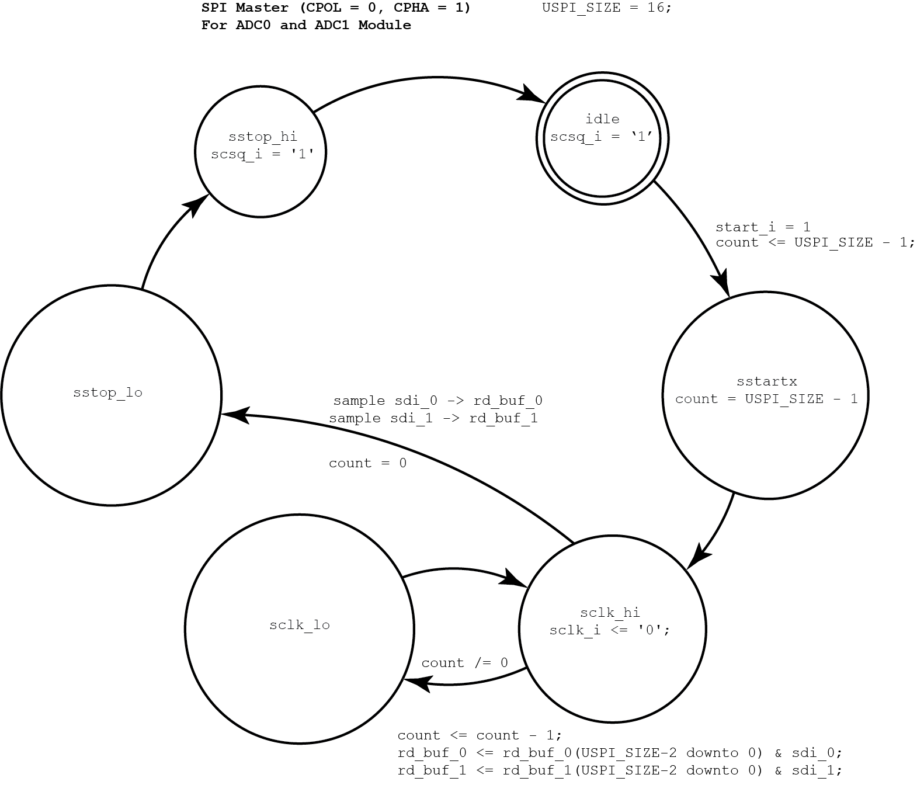
ADC0 and ADC1 Measurement
Dual-lane SPI interface for simultaneous acquisition of ADC0 and ADC1.
Reads two serial data streams, sdi_0 and sdi_1, in parallel.
Stores the results in rcvData_0 and rcvData_1.
Uses FSM-based control for SPI acquisition.
Provides raw ADC values to the system.

Slide 6
Hardware Design using VHDL
Temperature Measurement
For temperature measurement MAX31865 Pmod module is used.
It is a resistance-to-digital converter.
Resistance is converted into digital value by MAX31865.
Digital value is communicated with the zedboard through SPI.
Key features
Temperature measurement configuration
2-wire method (In MNG this method Is used)
3-wire method
4-wire method
15bit ADC resolution
21ms (max) Conversion Time
SPI communication

Slide 7
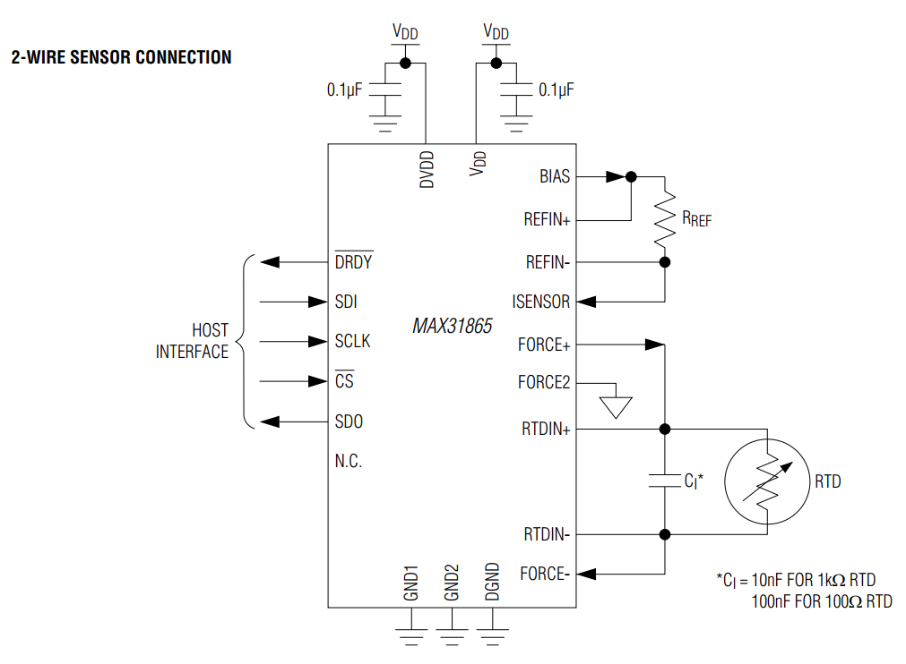
Hardware Design using VHDL
MAX31865 connection with Zedboard
Since we are using 2-wire connection, the MAX31865 should be connected to the zedboard as per the following circuit diagram.
Communication with the host is done through the SPI signals SDI, SDO, SCLK, and CS.
The DRDY pin can be used to indicate that a new conversion result is ready.
Based on MAX31865 datasheet, it support

Slide 8
Temperature measurement
For temperature measurement MAX31865 Pmod (resistance-to-digital converter. ) module is used.
Digital value is communicated with the zedboard through SPI.
For temperautre an SPI master (CPOL=1, CPHA=1) that sends and receives USPI_SIZE bits (default 16) over sdo/sdi is implemented.
There are 2 FSMs:
The first FSM (ssl_state) controls when a whole SPI transfer starts and ends.
ssl_idle: core is ready, done='1'; waits for start='1' and SPI FSM in sidle.
ssl_start: issues a one-clock start_i pulse to kick the SPI FSM, then moves to ssl_run.
ssl_run: waits until the SPI FSM returns to sidle, then goes back to ssl_idle and done becomes 1 again.
--first fsm.
sslcmb_proc: PROCESS(ssl_state, state, start)
BEGIN
sslnxt_state <= ssl_state;
start_i <= '0';
done <= '0';
CASE ssl_state IS
WHEN ssl_idle =>
done <= '1';
IF start='1' AND state=sidle THEN
sslnxt_state <= ssl_start;
END IF;
WHEN ssl_start =>
start_i <= '1';
IF state=sstartx THEN
sslnxt_state <= ssl_run;
END IF;
WHEN ssl_run =>
IF state=sidle THEN
sslnxt_state <= ssl_idle;
END IF;
END CASE;
END PROCESS sslcmb_proc;

Slide 9
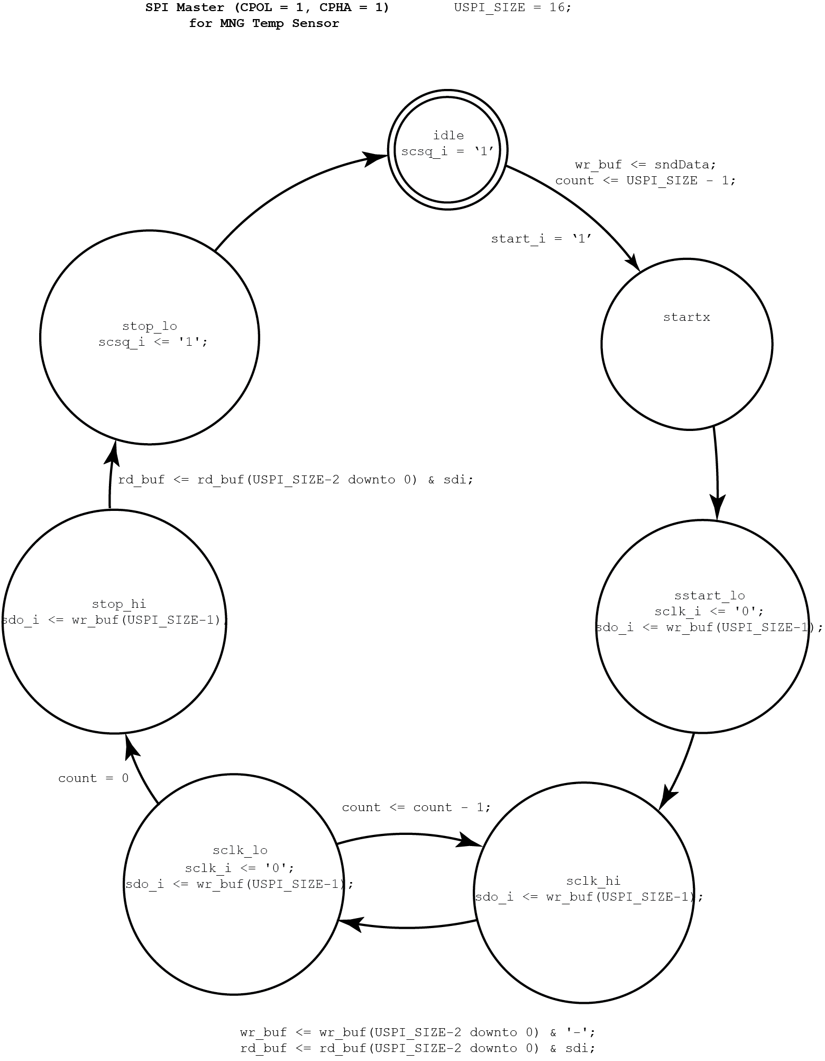
Temp SPI FSM
The SPI FSM (state) controls the bit-level SPI timing: scsq, sclk, and sdo, plus shifting registers.
sidle: CS high, clock high, idle. Waits for start_i='1', then goes to sstartx.
sstartx → sstart_lo: loads wr_buf with sndData, sets count = USPI_SIZE-1, pulls clock low and outputs the first MOSI bit.
sclk_hi / sclk_lo: main loop; on each bit it toggles sclk, shifts wr_buf, samples sdi into rd_buf, and decrements count until count = 0.
stop_hi → stop_lo: finishes the last bit, samples final sdi, deasserts CS, and returns to sidle, with the received word available in rcvData.

Slide 10
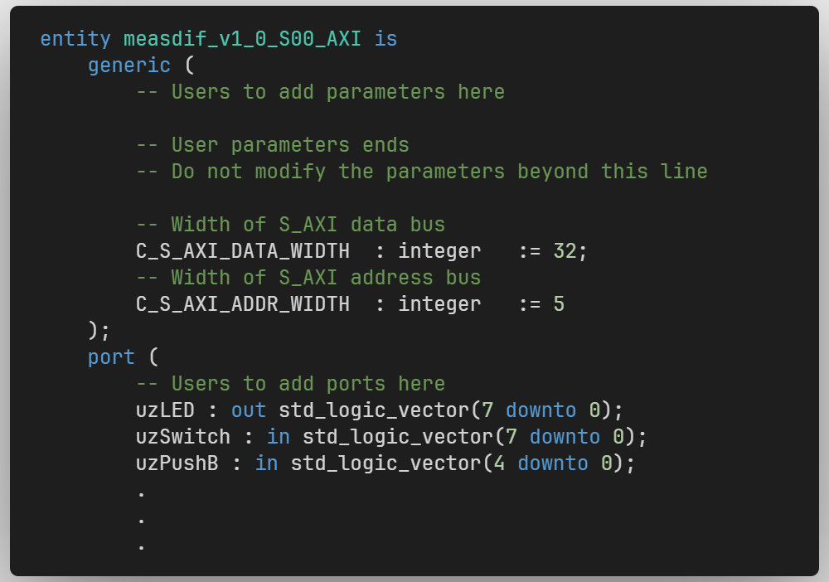
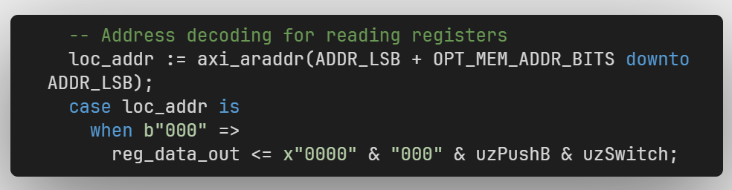
Push Buttons and Switches
The ZedBoard switches and pushbuttons are also integrated into the AXI interface as digital input measurements.
In the project, switches are sid_switches = 4 and pushbuttons are sid_pushb = 5.
The inputs are connected through uzSwitch(7 downto 0) and uzPushB(4 downto 0).
AXI read address 000 returns both input groups in one register.
The lower 8 bits contain the switch values, and the next 5 bits contain the pushbutton values.

Slide 11
Push Buttons and Switches
The ZedBoard switches and pushbuttons are also integrated into the AXI interface as digital input measurements.
In the project, switches are sid_switches = 4 and pushbuttons are sid_pushb = 5.
The inputs are connected through uzSwitch(7 downto 0) and uzPushB(4 downto 0).
AXI read address 000 returns both input groups in one register.
The lower 8 bits contain the switch values, and the next 5 bits contain the pushbutton values.

Slide 12
Sensors Integration with AXI Interface
Temperature
A write to AXI register 001 triggers max_start and sends slv_reg1(15 downto 0) to the MAX31865.
The SPI pins are connected through umCSn, umSCLK, umMOSI, and umMISO.
The status register at address 001 returns max_drdyn and max_done.
address 010 returns the received temperature data in MAX_Data.
--component instantiation
max_pmod: sph1pol1
GENERIC MAP ( USPI_SIZE => 16)
PORT MAP ( resetn => S_AXI_ARESETN,
bclk => S_AXI_ACLK,
spi_clkp => spi_transmp,
start => max_start,
done => max_done,
scsq => umCSn,
sclk => umSCLK,
sdo => umMOSI,
sdi => umMISO,
sndData => slv_reg1(15 downto 0),
rcvData => MAX_Data);
.
.
--writing to registers.
when b"001" =>
max_start <= '1';
for byte_index in 0 to (C_S_AXI_DATA_WIDTH/8-1) loop
if ( S_AXI_WSTRB(byte_index) = '1' ) then
-- Respective byte enables are asserted as per write strobes
-- slave registor 1

Slide 13
Sensors Integration with AXI Interface
Temperature
The status register at address 001 returns max_drdyn and max_done.
address 010 returns the received temperature data in MAX_Data.
process (slv_reg3, slv_reg6, slv_reg7, axi_araddr, S_AXI_ARESETN, slv_reg_rden,
uzSwitch, uzPushB, max_done, max_drdyn, MAX_Data, done_adc, ADC_Data)
variable loc_addr :std_logic_vector(OPT_MEM_ADDR_BITS downto 0);
begin
-- Address decoding for reading registers
loc_addr := axi_araddr(ADDR_LSB + OPT_MEM_ADDR_BITS downto ADDR_LSB);
case loc_addr is
when b"000" =>
reg_data_out <= x"0000" & "000" & uzPushB & uzSwitch;
when b"001" =>
reg_data_out <= x"0000000" & "00" & max_drdyn & max_done;
when b"010" =>
reg_data_out <= x"0000" & MAX_Data;

Slide 14
Sensors Integration with AXI Interface
ADC0 & ADC1
ADC_Data(15 downto 0) contains ADC0, while ADC_Data(31 downto 16) contains ADC1.
adcRX : adc2lane
GENERIC MAP ( USPI_SIZE => 16 )
PORT MAP ( resetn => S_AXI_ARESETN,
bclk => S_AXI_ACLK,
spi_clkp => spiclk_p,
start => start_adc,
done => done_adc,
scsq => uAD1csq,
sclk => uAD1Sclk,
sdi_0 => usdiAD_0,
sdi_1 => usdiAD_1,
rcvData_0 => ADC_Data(15 downto 0),
rcvData_1 => ADC_Data(31 downto 16));

Slide 15
Sensors Integration with AXI Interface
process (slv_reg3, slv_reg6, slv_reg7, axi_araddr, S_AXI_ARESETN, slv_reg_rden,
uzSwitch, uzPushB, max_done, max_drdyn, MAX_Data, done_adc, ADC_Data)
variable loc_addr : std_logic_vector(OPT_MEM_ADDR_BITS downto 0);
begin
-- Address decoding for reading registers
loc_addr := axi_araddr(ADDR_LSB + OPT_MEM_ADDR_BITS downto ADDR_LSB);
case loc_addr is
when b"000" =>
reg_data_out <= x"0000" & "000" & uzPushB & uzSwitch;
when b"001" =>
reg_data_out <= x"0000000" & "00" & max_drdyn & max_done;
when b"010" =>
reg_data_out <= x"0000" & MAX_Data;
when b"011" =>
reg_data_out <= slv_reg3;
when b"100" =>
reg_data_out <= x"0000000" & "000" & done_adc;
when b"101" =>
reg_data_out <= ADC_Data;
when b"110" =>
reg_data_out <= slv_reg6;
when b"111" =>
reg_data_out <= slv_reg7;
when others =>
reg_data_out <= (others => '0');
end case;
end process;
ADC0 & ADC1
ADC_Data(15 downto 0) contains ADC0, while ADC_Data(31 downto 16) contains ADC1.
001 / 010: MAX31865 temperature status and data.
100 / 101: ADC start, done, ADC0 and ADC1 data.
000: pushbuttons and switches input register.

Slide 16
Sensors Integration with AXI Interface
Temperature, ADC0, and ADC1 modules are integrated into the top-level VHDL file.
The top file combines all sensor submodules into one custom hardware block.
MAX31865, ADC channels, switches, and pushbuttons are connected in the same AXI-based design.
All measurements are accessible to the processor through one custom peripheral.
Add the processor system and connect the AXI-related signals to the custom IP.
Add the .xdc file for pin assignments and timing constraints.
Synthesize and implement the complete hardware design.
Generate the FPGA bitstream.
Export the hardware as an .xsa file for software development and deployment.
Using the .xsa file, we are able to generate a petalinux.

Slide 17
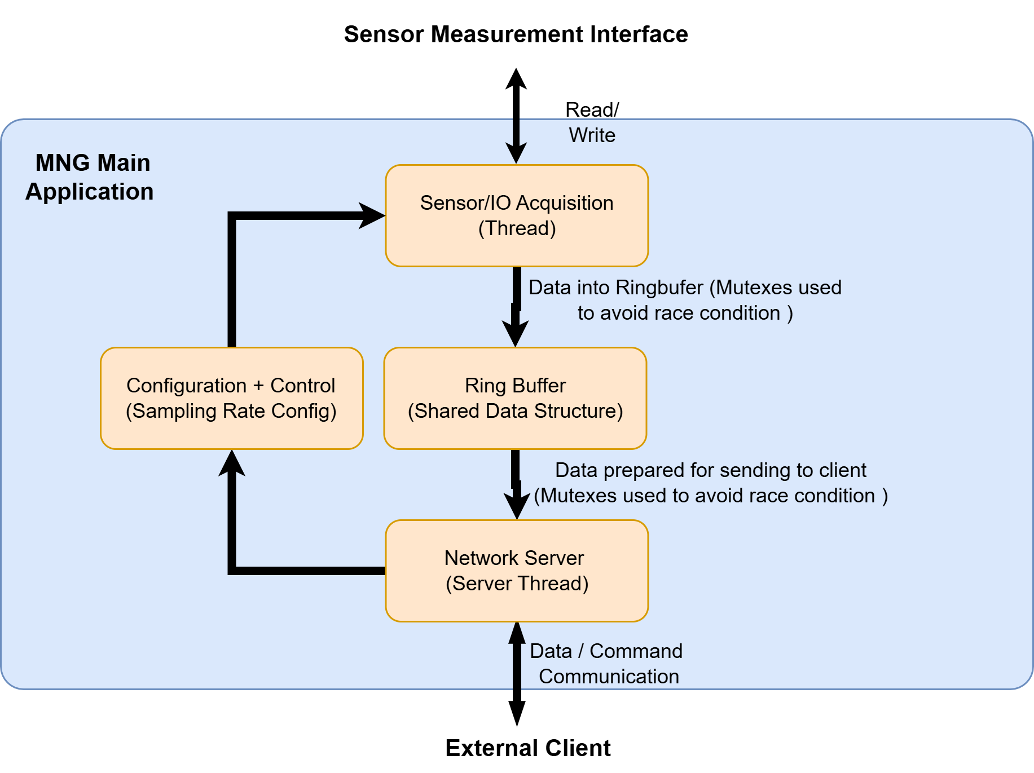
Application for MNG
The application is based on two main threads.
The sensor thread acquires data from the hardware and stores it in the ring buffer.
The server thread communicates with the external client over TCP/IP and sends the buffered measurement packets.
The server thread can receive the configuration from the user (external client) and can safely pass it to the sensor thread.

Slide 18
Sensor Thread Overview
void *sensor_thread_function(void *arg)
{
(void)arg;
int TempInitializerFlag = 0;
printf("Sensor thread started...\n");
int fd = open("/dev/meascdd", O_RDWR);
if (fd < 0) {
simulation = 1;
printf("Device open failed - simulation mode\n");
} else {
printf("Device opened successfully\n");
}
InitTimer();
InitRingBuffer();
if (!simulation) {
if (TempPowerUp(fd) != 1) {
printf("Temperature sensor init failed\n");
} else {
printf("Temperature sensor initialized\n");
TempInitializerFlag = 1;
}
}
Runs in its own thread, independent of the server.
The sensor thread initializes the hardware interface and starts the timer and ring buffer.
Initializes the temperature sensor.
It opens the device (/dev/meascdd)
If failed then -> simulation mode.
It initiate the timer and the ring buffer.
It periodically reads temperature, ADC0, ADC1, switches, and pushbuttons according to the active configuration.
The measured values are sensor ID, timestamp, and value then they are pushed into the ring buffer.
Reacts to configuration changes at runtime.
On exit, shuts down the temperature sensor (if used), closes the device file

Slide 19
Sampling period calculation
Each sensor has a rate in Hz: temp_config, adc0_config, adc1_config, switch_config, pushb_config.
For enabled sensors, the thread computes period_us = 1000000 / rate to get microseconds between samples.
It keeps a separate next_time per sensor and samples when current_time >= next_time.
After each sample, it does next_time += period_us, so each sensor runs at its own configured rate.
A rate of 0 disables that sensor (no period, never scheduled).
int temp_enabled = (cfg.temp_config > 0);
int adc0_enabled = (cfg.adc0_config > 0);
int adc1_enabled = (cfg.adc1_config > 0);
int switch_enabled = (cfg.switch_config > 0);
int pushb_enabled = (cfg.pushb_config > 0);
uint64_t period_temp_us = temp_enabled ? (1000000ULL / cfg.temp_config) : 0;
uint64_t period_adc0_us = adc0_enabled ? (1000000ULL / cfg.adc0_config) : 0;
uint64_t period_adc1_us = adc1_enabled ? (1000000ULL / cfg.adc1_config) : 0;
uint64_t period_switch_us = switch_enabled ? (1000000ULL / cfg.switch_config) : 0;
uint64_t period_pushb_us = pushb_enabled ? (1000000ULL / cfg.pushb_config) : 0;

Slide 20
Sensor reading loop
The thread periodically reads all the sensor based on the sampling frequency. as an example, the
continuous reading of the ADC sensor is shown here.
After reading each sensor periodically it stores the sensor data inside a ring buffer.
/* ---- ADC0 ---- */
if (adc0_enabled && current_time >= next_adc0_time) {
if (simulation) {
t_adc0 += 1.0 / cfg.adc0_config;
adc0_data = (uint32_t)(fake_state.adc0_base +
100.0 * sin(2.0 * PI * freq_adc0 * t_adc0));
} else { GetADC(fd, &adc0_data, &dummy0);}
PushRB(sid_adc0, current_time, adc0_data);
printf("A0=%u ", adc0_data);
next_adc0_time = current_time + period_adc0_us;
printed_anything = 1;
}

Slide 21
Server Thread (Main Functions)
Server thread is another part of the main application which is responsible for the communication between the client and the server.
The server thread opens a TCP server on port 50012.
The client is able to send command and configuration for the sampling rate.

Slide 22
Server Creation
The server thread creates a TCP socket
binds it to a specific port,
listens for incoming client connections.
The server enters a loop and waits for client connections.
When a client connects:
A new socket (client_sock) is created.
Communication with the client uses this socket.
int server_sock = socket(AF_INET, SOCK_STREAM, 0);
bind(server_sock, (struct sockaddr *)&server_address, sizeof(server_address));
listen(server_sock, 1);
while (!g_shutdown)
{
printf("Waiting for client...\n");
int client_sock = accept(server_sock,
(struct sockaddr *)&client_addr,
&client_addr_len);
}

Slide 23
Client handling loop
The server receives commands from the client
recv() reads incoming data
MSG_DONTWAIT makes the receive non-blocking
/* ---- INNER LOOP: serve one client ---- */
while (!g_shutdown)
{ memset(receive_command, 0, CMD_BUF_SIZE);
int n = recv(client_sock,
receive_command,
CMD_BUF_SIZE - 1,
MSG_DONTWAIT);

Slide 24
Start command
/* ---- start ---- */
if (!strcmp(receive_command, "start"))
{
int available;
pthread_mutex_lock(&server_thread.thmutex);
available = Ring_Buf.rb_cnt;
pthread_mutex_unlock(&server_thread.thmutex);
if (available > 0) {
int to_send = (available >= ServerPayloadSize) ? ServerPayloadSize : available;
for (int i = 0; i < to_send; i++) {
if (PopRB(&payload[i].sid,
&payload[i].ts,
&payload[i].svalue) < 0) {
to_send = i;
break;
}
}
if (to_send > 0) {
ssize_t sent = send(client_sock, payload,
to_send * sizeof(packet), 0);
if (sent <= 0) { perror("send"); break; }
printf("Sent %d packets\n", to_send);
Check Ring Buffer: Reads Ring_Buf.rb_cnt to see how many samples are available (under mutex lock)
Calculate Payload: Computes to_send = min(available, ServerPayloadSize=93) packets to pop
Pop Packets: Calls PopRB() repeatedly to extract sensor_id, timestamp, and value for each packet
Atomic Send: Sends all packets in ONE send() call as a binary burst over TCP (request-response model)
Log Result: Prints "Sent N packets" if successful, or "ring buffer empty" if nothing to send
State Update: Sets stream_state = PAUSED after sending (not continuous streaming)
No Backpressure: If buffer is empty, client gets nothing—no error, just waits for next poll

Slide 25
Configure command
else if (!strncmp(receive_command, "configure ", 10))
{
config_struct cfg;
int parsed = sscanf(&receive_command[10], "%u %u %u %u %u", &cfg.temp_config, &cfg.adc0_config, &cfg.adc1_config, &cfg.switch_config, &cfg.pushb_config);
if (parsed == 5)
{
set_config(&cfg);
ClearRB();
print_config();
}
else
printf("Bad configure arguments\n");
}
Detects a command string starting with "configure " from the client.
Parses five unsigned integers: temp_config, adc0_config, adc1_config, switch_config, pushb_config.
Calls set_config(&cfg) to copy these values into the global main_config under a mutex (thread-safe update).
Calls ClearRB() to empty the ring buffer so old samples (with old rates) are discarded.
Calls print_config() to print the new configuration to the console for verification/debugging.
void set_config(config_struct *config)
{
pthread_mutex_lock(&server_thread.thmutex);
main_config.temp_config = config->temp_config;
main_config.adc0_config = config->adc0_config;
main_config.adc1_config = config->adc1_config;
main_config.switch_config = config->switch_config;
main_config.pushb_config = config->pushb_config;
pthread_mutex_unlock(&server_thread.thmutex);
}

Slide 26
Shutdown command
else if (!strcmp(receive_command, "shutdown"))
{
printf("Shutdown command received - stopping server\n");
stream_state = SHUTDOWN;
shutdown(client_sock, SHUT_RDWR);
close(client_sock);
pthread_mutex_lock(&g_socket_lock);
g_client_socket = -1;
pthread_mutex_unlock(&g_socket_lock);
request_shutdown();
pthread_mutex_lock(&sensor_thread.thmutex);
sensor_thread.thkill = 1;
pthread_mutex_unlock(&sensor_thread.thmutex);
break;
}
static void request_shutdown(void)
{
g_shutdown = 1;
pthread_mutex_lock(&g_socket_lock);
if (g_client_socket >= 0)
{
shutdown(g_client_socket, SHUT_RDWR);
close(g_client_socket);
g_client_socket = -1;
}
if (g_server_socket >= 0)
{
shutdown(g_server_socket, SHUT_RDWR);
close(g_server_socket);
g_server_socket = -1;
}
pthread_mutex_unlock(&g_socket_lock);}
Detects the "shutdown" command string from the connected client.
Logs that a shutdown was requested and sets stream_state = SHUTDOWN.
Calls shutdown(client_sock, SHUT_RDWR); and close(client_sock);, then clears the global client socket handle.
Invokes request_shutdown(), which sets g_shutdown = 1, shuts down and closes the listening/server sockets.
Sets sensor_thread.thkill = 1 under its mutex so the sensor thread exits its loop.
With g_shutdown set, both inner and outer server loops end, the thread returns, and main() can join threads and terminate cleanly.

Slide 27
MNG GUI (client)
GUI layout (Objective)
Provides a user-friendly interface for configuring and monitoring the network sensor client.
Displays real-time sensor data visually.
Main Component
IP Entry Text field to enter server IP (gtk_entry_get_text(app->ip_entry))
Port Entry Text field for server port (gtk_entry_get_text(app->port_entry))
Connect / Disconnect Button Starts or stops the network thread
Status Label Shows connection status: Connected / Disconnected / Error
Sensor Display / Graph Real-time plotting of sensor data from the ring buffer
Terminal/Log Window Displays runtime messages: connection info, errors, received data (log_msg())

Slide 28
MNG GUI (client)
Network thread function:
Handles TCP connection to the server.
Receives sensor data continuously.
Updates the local buffer for GUI plotting.
Workflow:
Create socket
Set server address → IP from GUI, port from GUI or default 50012
Once connected, marks net_connected = 1 and repeatedly recv()s data into a buffer
Features
Runs in its own thread.
Uses mutex (pthread_mutex_lock) to safely update sensor buffers
Automatic reconnection on errors

Slide 29
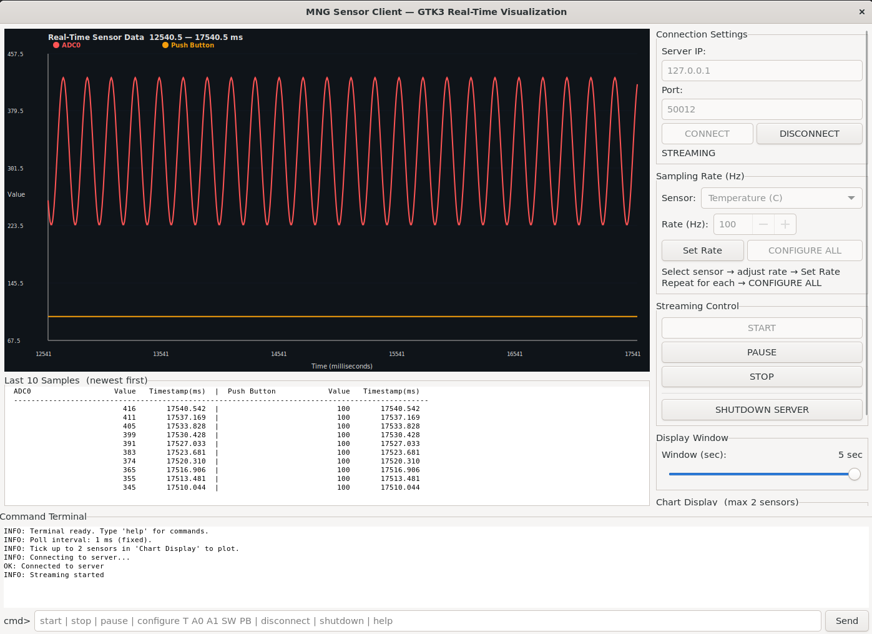
MNG GUI (client)

Slide 30
Conclusion
Successfully implemented the VHDL design for the embedded system, ensuring correct logic and timing.
Developed a real-time application to process and visualize data from sensors, with robust error handling and network connectivity.
Designed a user-friendly GUI and terminal interface, enabling intuitive monitoring and interaction with the system.
Overall, the project demonstrates the integration of hardware design, software application, and user interface for a complete embedded system solution.

